Slide 1
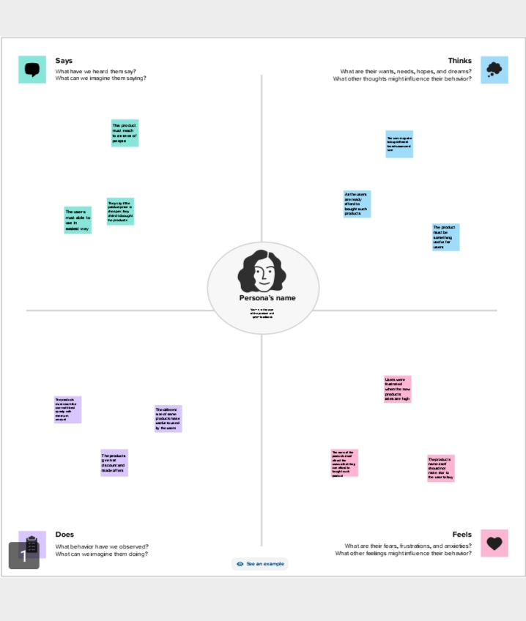
1.INTRODUTION :
1.1.OVER VIEW
Fashion is an art form that allows individuals to express themselves through clothing and accessories. It is a constantly evolving industry that is influenced by cultural, social, and economic factors. In recent years, several types of fashion have emerged, each with its own unique characteristics and appeal.
1.2.Problem definitoin &Design thinking
2.1.Empathy Map:
2.2.Ideation definition &Brainstorming map

Slide 2
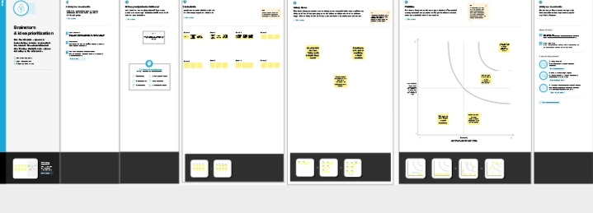

3.Results ;
3.1.AR summary :

Slide 3
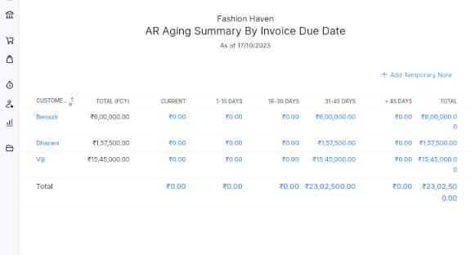
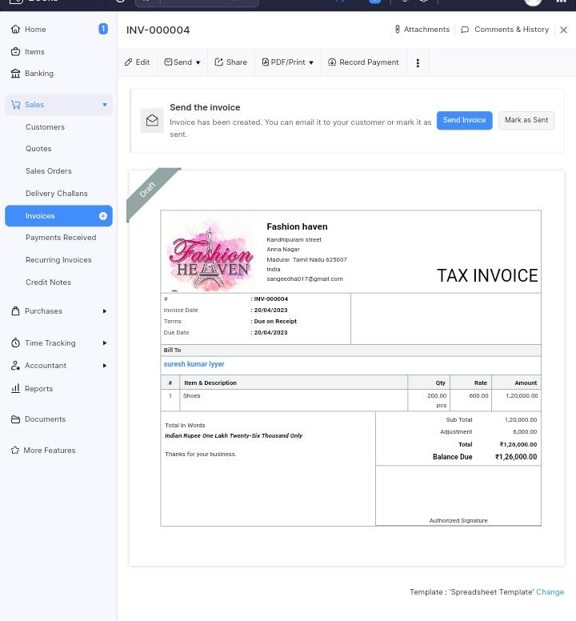
3.2. AR summary
3.3.sale invoice

Slide 4
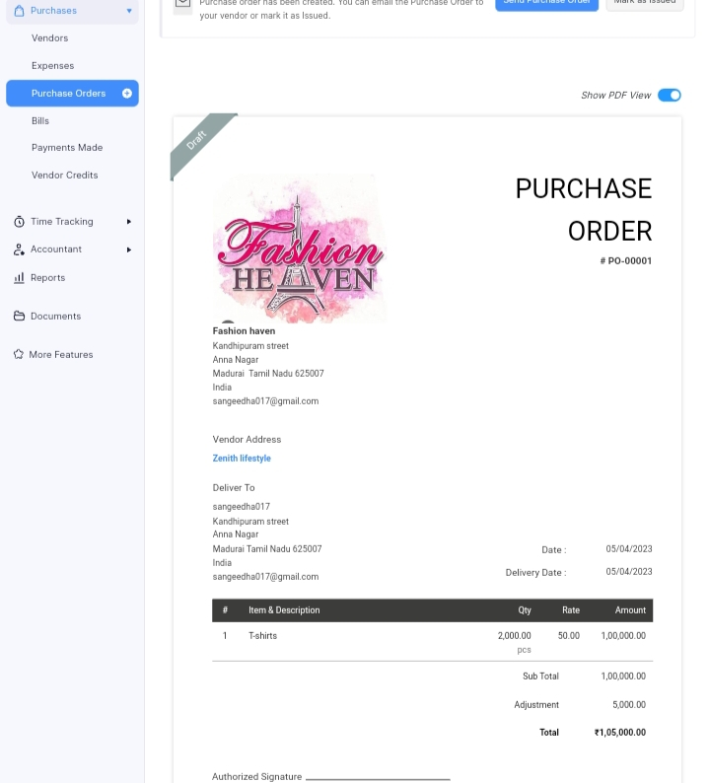
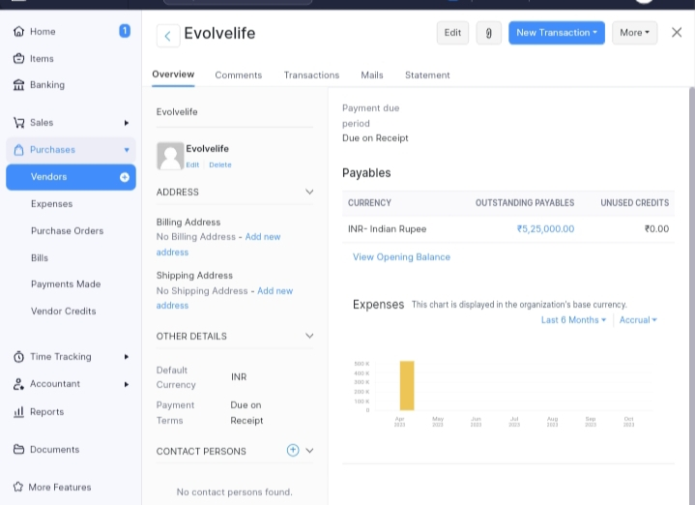
3.4. purchase Bills :
3.5.vendors :

Slide 5


3.6.customer
3.7.jounal :

Slide 6

3.8. Banking :
4:Advantages and disadvantages :
•Confidence boost.
•Sense of accomplishment.
•Consistent wardrobe.
•Creativity.
•Happiness boost.
•Better focus.

Slide 7
4.2 Disadvantages:
•Fashion trends can create social pressure to conform, leading to a lack of individuality and self-expression.
•Some people may not like the idea of buying secondhand cloth
•There might be a lack of option available
5.Conclusion :
fashion design is a constantly evolving field that provides opportunities to express personal style and unique ideas.

Slide 8
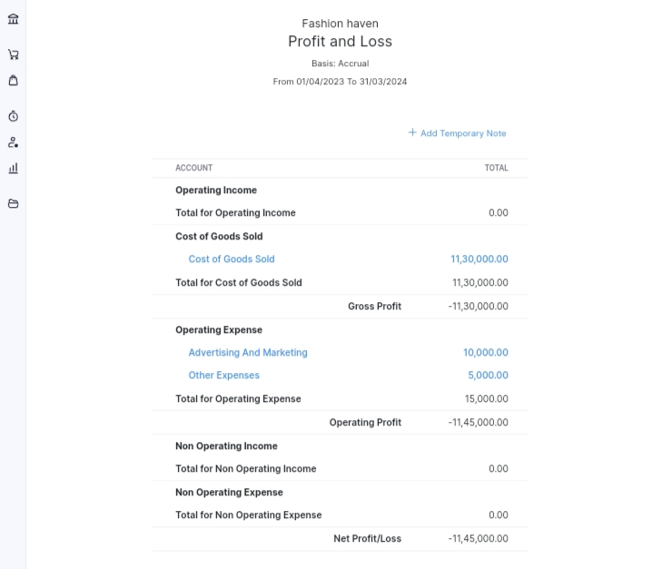

6.1 .profit and loss Account :
6.2 .Balance sheet :

Slide 9
7.Future scop :
Fashion designing is considered to be an extraordinary course and has an extraordinary scope as well. For instance, the rise in the E-commerce fashion world, wherein you can purchase all your outfits and accessories online has led to an inclination in the demand for fashion designers as well.

